Slide 1
TRUE COLORS ASSESSMENT
Youth Leadership Symposium
Saturday, February 3, 2024

Slide 2
Discovering Our Personality Style
Through TRUE COLORS

Slide 3
Outcomes:
In this module participants will:
  Discover the qualities and characteristics of their own particular personality style or type
  Gain an understanding of the other personality styles

Slide 4
Key Concepts:
  True Colors is a self-reporting technique
  True Colors is a metaphor
  Each person is a unique blend of the four colors or styles – a spectrum
  There are no bad or good colors, each offers unique qualities, strengths, and challenges
  There are wide individual variations within each color spectrum
  We can elevate our least preferred color style to meet situational needs

Slide 5
Assessment Instructions:
In the boxes are groups of word clusters printed horizontally in rows
Look at all the word cluster choices in the first row (A,B,C,D).
Select the word cluster that is most like you. Give that word cluster a 4 and write 4 in the score box
Then rank order the next 3-word clusters in row 1 from 3 to 1 in descending preference. Write 3, 2 and 1 in the corresponding score boxes
4 is most like you, 1 is least like you
Continue this process for each row.

Slide 6
Assessment Instructions Cont.:
Once you have completed your selections for each row and have entered in your scores, you may now tally
To tally, add up the scores in each color box at the bottom of the assessment
Total ORANGE Score is from boxes A,H,K,N,S
Total GREEN Score is from boxes D,E,L,P,Q
Total BLUE Score is from boxes C,F,J,O,R
Total GOLD Score is from boxes B,G,I,M,T

Slide 7

CONGRATULATIONS!
You now know your color spectrum!

Slide 8
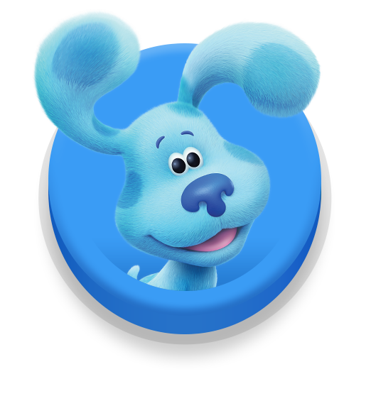

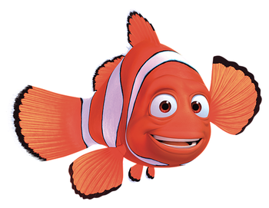
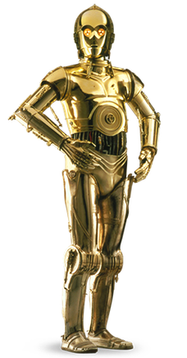
Let’s Talk About Our Colors

Slide 9
Notes:
**To delete the placeholder photo click the photo and hit delete. To add a picture click on the picture icon in the middle and select your photo. If you need to adjust your photo within the photo frame click the photo and then navigate to the “Picture Format” tab above. Then click “Crop Photo.” To enlarge or minimize your photo proportionally hold down the ”shift key” while clicking and dragging any of the corners of the photo. Then to move the photo within the crop box hover over any of the edges of the photo and drag the photo to your desired position (note when you hover you will see a four arrow cross.) After you have positioned your photo click the “crop photo” button up top to exit the crop photo mode.

Slide 10
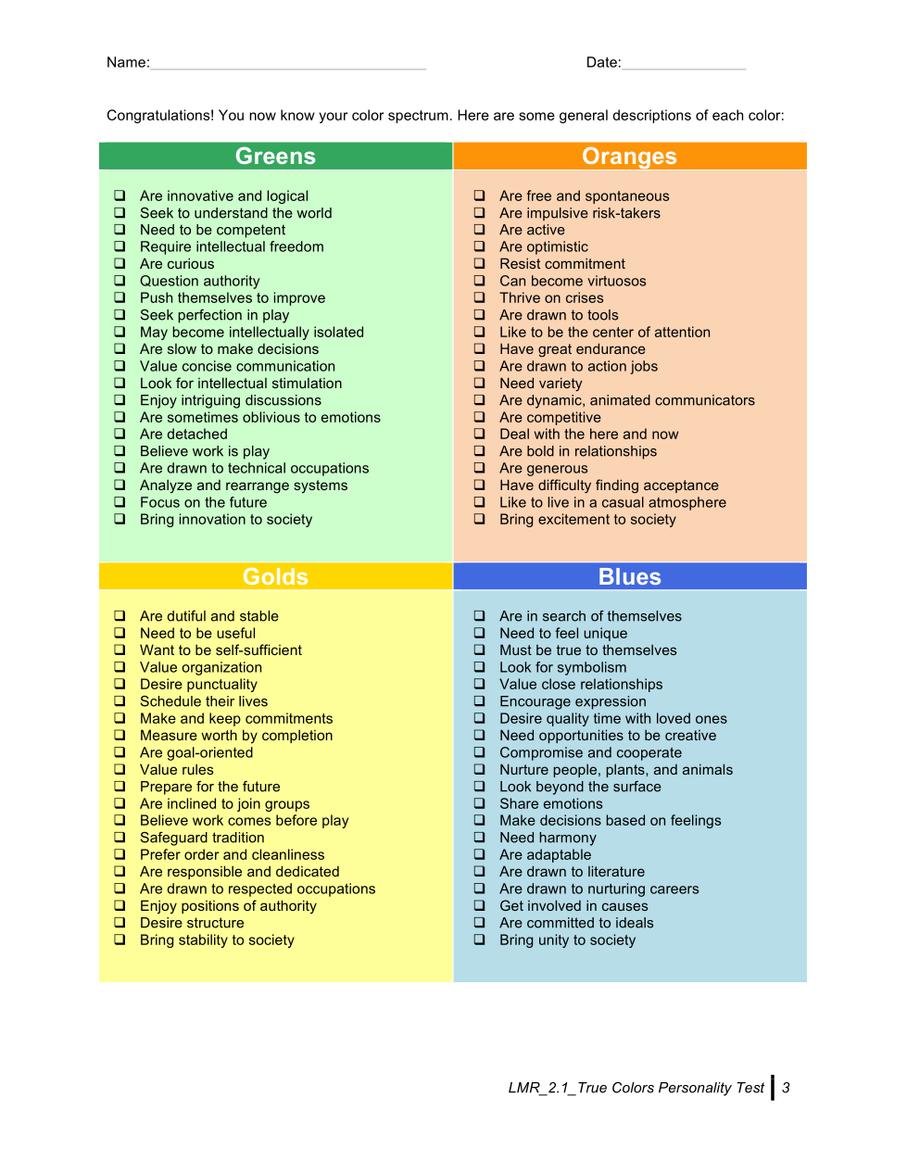
Notes:
**To delete the placeholder photo click the photo and hit delete. To add a picture click on the picture icon in the middle and select your photo. If you need to adjust your photo within the photo frame click the photo and then navigate to the “Picture Format” tab above. Then click “Crop Photo.” To enlarge or minimize your photo proportionally hold down the ”shift key” while clicking and dragging any of the corners of the photo. Then to move the photo within the crop box hover over any of the edges of the photo and drag the photo to your desired position (note when you hover you will see a four arrow cross.) After you have positioned your photo click the “crop photo” button up top to exit the crop photo mode.

Slide 11
Leadership Styles:
BLUE (Nurturer, relationship-centered):
  Expects others to express views
  Assumes “family spirit”
  Works to develop others’ potential
  Individuals oriented
  Democratic, unstructured approach
  Encourages change via human potential
  Expects people to develop their potential
GOLD (Stabilizer, institution-oriented):
  Expects punctuality, order and loyalty
  Assumes “right” way to do things
  Rules oriented
  Detailed/thorough approach
  Change can be challenging
  Expects people to follow through on their roles
Notes:
**To edit the table click on the table and then click on the ”layout tab” beside the “table design” tab up top. To add another row or column select any table cell and click “insert above,” ”insert below,” ”insert left,” or ”insert right”

Slide 12
Leadership Styles Cont.:
GREEN (Visionary, strategically-centered):
  Expects intelligence and competence
  Assumes task relevancy
  Seeks way to improve systems
  Visionary
  Analytical
  Encourages change for improvement
  Constantly “in process” of change
  Expects people to follow through
ORANGE (Trouble-shooter, action-oriented):
  Expects quick action
  Assumes flexibility
  Works in the here and now
  Performance oriented
  Flexible approach
  Welcomes change and institutes changes quickly
  Expects people to “make it fun”
Notes:
**To edit the table click on the table and then click on the ”layout tab” beside the “table design” tab up top. To add another row or column select any table cell and click “insert above,” ”insert below,” ”insert left,” or ”insert right”

Slide 13
Student Stressors:
BLUE
  Placing the “system as a priority over the people
  Conflict
  Negative criticism
  Being compared to others and not evaluated as an individual
GOLD
  Ambiguous demands
  Disorganization
  Irresponsibility of others
  Changing details
GREEN
  Lack of independence
  Incompetence
  Lack of options
  Inability to use or display knowledge
  Subjective judgement
ORANGE
  Rules
  Responsibility
  Redundancy
  Deadlines
  Stuck in a lecture only class
  Structure
  Emphasis on process over results
“In times of stress, the best thing we can do for each other is to listen with our ears and our hearts and to be assured that our questions are just as important as our answers.” – Fred Rogers
Notes:
You can find more factors creating stress in your packet.

Slide 14
Working with BLUE
Notes:
**To delete the placeholder photo click the photo and hit delete. To add a picture click on the picture icon in the middle and select your photo. If you need to adjust your photo within the photo frame click the photo and then navigate to the “Picture Format” tab above. Then click “Crop Photo.” To enlarge or minimize your photo proportionally hold down the ”shift key” while clicking and dragging any of the corners of the photo. Then to move the photo within the crop box hover over any of the edges of the photo and drag the photo to your desired position (note when you hover you will see a four arrow cross.) After you have positioned your photo click the “crop photo” button up top to exit the crop photo mode.

Slide 15
Working with GOLD
Notes:
**To delete the placeholder photo click the photo and hit delete. To add a picture click on the picture icon in the middle and select your photo. If you need to adjust your photo within the photo frame click the photo and then navigate to the “Picture Format” tab above. Then click “Crop Photo.” To enlarge or minimize your photo proportionally hold down the ”shift key” while clicking and dragging any of the corners of the photo. Then to move the photo within the crop box hover over any of the edges of the photo and drag the photo to your desired position (note when you hover you will see a four arrow cross.) After you have positioned your photo click the “crop photo” button up top to exit the crop photo mode.

Slide 16
Working with GREEN
Notes:
**To delete the placeholder photo click the photo and hit delete. To add a picture click on the picture icon in the middle and select your photo. If you need to adjust your photo within the photo frame click the photo and then navigate to the “Picture Format” tab above. Then click “Crop Photo.” To enlarge or minimize your photo proportionally hold down the ”shift key” while clicking and dragging any of the corners of the photo. Then to move the photo within the crop box hover over any of the edges of the photo and drag the photo to your desired position (note when you hover you will see a four arrow cross.) After you have positioned your photo click the “crop photo” button up top to exit the crop photo mode.

Slide 17
Working with ORANGE
Notes:
**To delete the placeholder photo click the photo and hit delete. To add a picture click on the picture icon in the middle and select your photo. If you need to adjust your photo within the photo frame click the photo and then navigate to the “Picture Format” tab above. Then click “Crop Photo.” To enlarge or minimize your photo proportionally hold down the ”shift key” while clicking and dragging any of the corners of the photo. Then to move the photo within the crop box hover over any of the edges of the photo and drag the photo to your desired position (note when you hover you will see a four arrow cross.) After you have positioned your photo click the “crop photo” button up top to exit the crop photo mode.

Slide 18
Notes:
**To delete the placeholder photo click the photo and hit delete. To add a picture click on the picture icon in the middle and select your photo. If you need to adjust your photo within the photo frame click the photo and then navigate to the “Picture Format” tab above. Then click “Crop Photo.” To enlarge or minimize your photo proportionally hold down the ”shift key” while clicking and dragging any of the corners of the photo. Then to move the photo within the crop box hover over any of the edges of the photo and drag the photo to your desired position (note when you hover you will see a four arrow cross.) After you have positioned your photo click the “crop photo” button up top to exit the crop photo mode.

Slide 19
QUESTIONS???
Notes:
**To delete the placeholder photo click the photo and hit delete. To add a picture click on the picture icon in the middle and select your photo. If you need to adjust your photo within the photo frame click the photo and then navigate to the “Picture Format” tab above. Then click “Crop Photo.” To enlarge or minimize your photo proportionally hold down the ”shift key” while clicking and dragging any of the corners of the photo. Then to move the photo within the crop box hover over any of the edges of the photo and drag the photo to your desired position (note when you hover you will see a four arrow cross.) After you have positioned your photo click the “crop photo” button up top to exit the crop photo mode.

Slide 20
Final Thought
Your palest color is one you can concentrate on understanding the most. It is with this color you will experience growth by taking risks and exploring a part of yourself that you know least well.
Personality styles, types, colors, etc. are not the whole story but they are a foundation upon which human behavior is based. Ultimately, YOU define who you are!
Notes:
**To delete the placeholder photo click the photo and hit delete. To add a picture click on the picture icon in the middle and select your photo. If you need to adjust your photo within the photo frame click the photo and then navigate to the “Picture Format” tab above. Then click “Crop Photo.” To enlarge or minimize your photo proportionally hold down the ”shift key” while clicking and dragging any of the corners of the photo. Then to move the photo within the crop box hover over any of the edges of the photo and drag the photo to your desired position (note when you hover you will see a four arrow cross.) After you have positioned your photo click the “crop photo” button up top to exit the crop photo mode.

